Slide 1
How to use this file
This file serves three purposes:
Act as a branding guideline and resource for Dapr
Provide a core set of slides to use when presenting Dapr
Provide additional slides for deep-dive presentations
How to request updates this file:
Create an issue in https://github.com/dapr/community with details on what you’d like to add/update

Slide 2







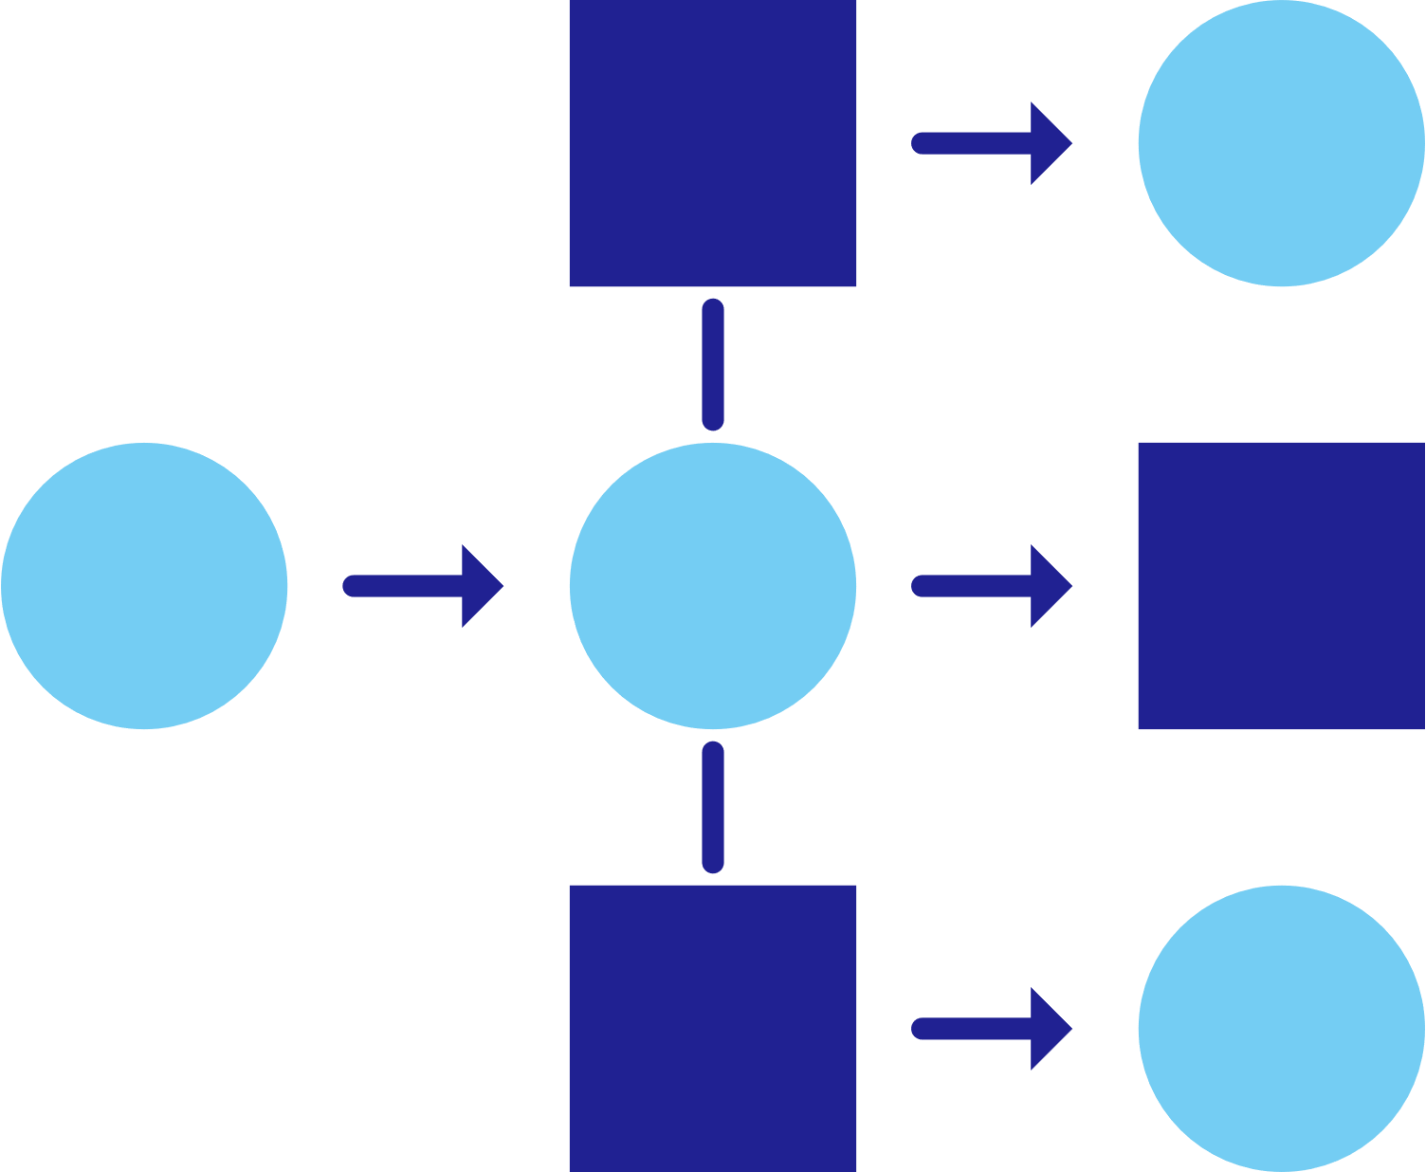











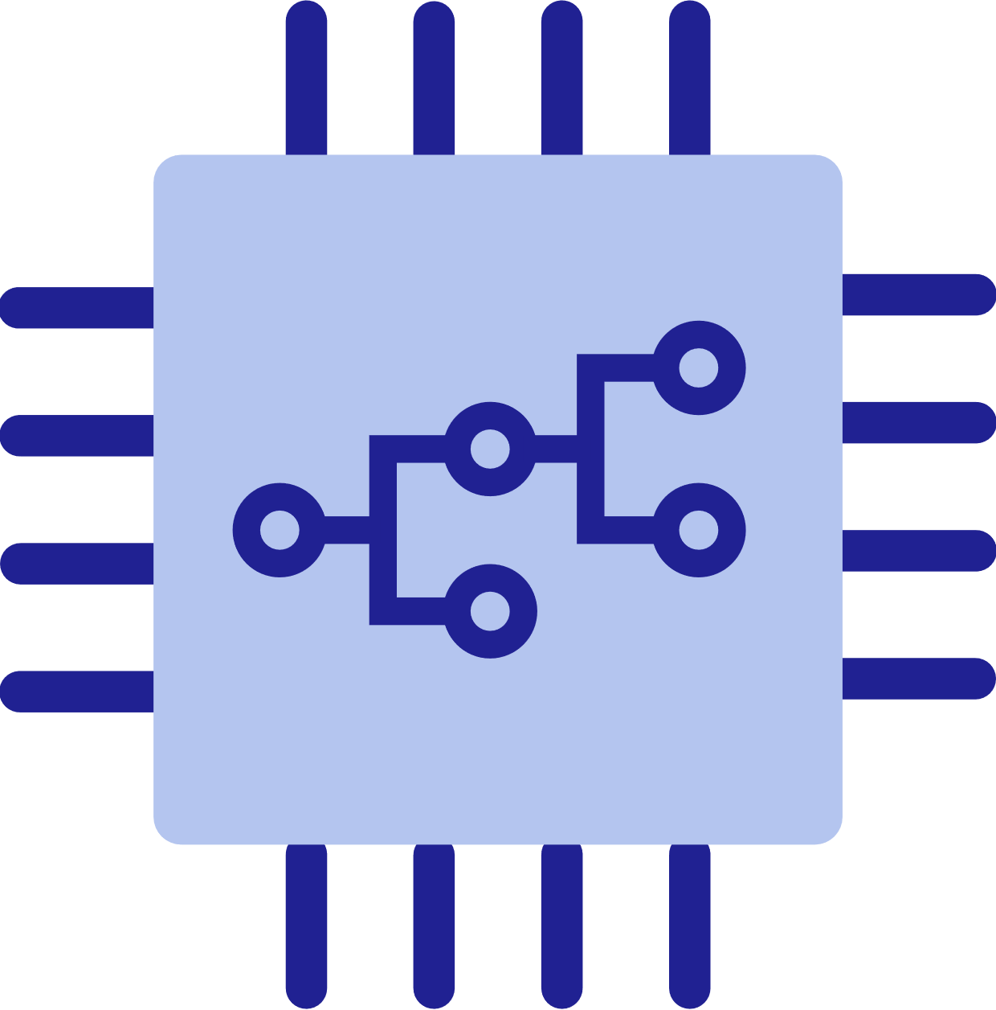

Icons
Encryption
User
Configuration
Key/secret
Blue logo
(preferred)
Black logo
White logo
Service
invocation
State
management
Publish and subscribe
Resource bindings
and triggers
Actors
Observability
Secrets
App 1
App 2
App 3
Sidecar
Cloud
Edge
Self-hosted

Slide 3
Building diagrams
Apps and services are represented by a hexagon with shadow
App title is in Segoe UI Semibold
When more than one application is present in a diagram, alternate hexagon colors
The Dapr sidecar is represented by a white hexagon with the Dapr logo
Sidecar icon can be in any corner if needed, although the bottom right is preferred
Arrows connecting applications is 2.25pt weight, #202192 color
Always use right-angle turns and not curves when connecting items not inline with each other
My App
Your App

Slide 4
Dapr Distributed Application Runtime
Antonio Liccardi

Slide 5
State of enterprise developers
Deploying scale-out apps for flexibility, cost, and efficiency
Developing resilient, scalable, microservice-based apps that interact with services
Focusing on
building applications, not infrastructure
Trending toward serverless platforms with simple code to cloud pipelines
Using multiple languages and frameworks during development

Slide 6
What is holding back microservice development?
Limited tools and runtimes to build distributed applications
Runtimes have limited language support and tightly controlled feature sets
Runtimes only target specific infrastructure platforms with limited portability

Slide 7



Distributed app development E-commerce app
Inventory
Email
Payment
RCMD
Frontend
Cart
Checkout
Internet
Azure
CosmosDB
Shipping
Kafka

Slide 8
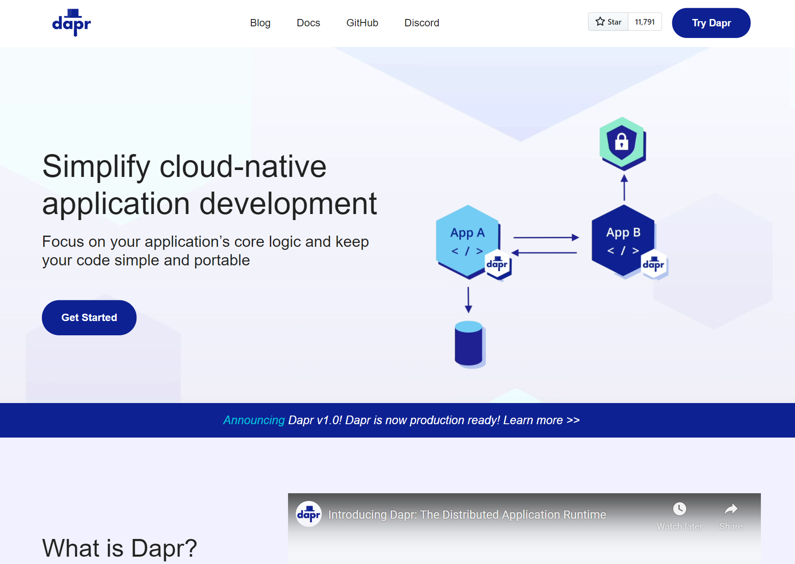
Distributed Application Runtime
Portable, event-driven, runtime for building distributed applications across cloud and edge
dapr.io

Slide 9
Dapr Goals
Best-practices building blocks
Any language or framework
Consistent, portable, open APIs
Adopt standards
Extensible and pluggable components
Platform agnostic cloud + edge
Community driven, vendor neutral

Slide 10
Microservice building blocks
HTTP API
gRPC API
Service-to-service invocation
State management
Publish and subscribe
Resource bindings and triggers
Actors
Observability
Secrets
Extensible

Slide 11







Any language and framework
Standard APIs accessed over http/gRPC protocols from user service code
Runs as local “side car library” dynamically loaded at runtime for each service
Application code
Microservices written in
Any code or framework…
HTTP API
gRPC API
Service-to-service invocation
State management
Publish and subscribe
Resource bindings and triggers
Actors
Observability
Secrets
Extensible

Slide 12







Any cloud or edge infrastructure
Application code
Microservices written in
Any code or framework…
HTTP API
gRPC API
Service-to-service invocation
State management
Publish and subscribe
Resource bindings and triggers
Actors
Observability
Secrets
Extensible
Hosting infrastructure
Azure Arc
On-Premises

Slide 13
Sidecar model
Application
Dapr sidecar
My App
Dapr API
HTTP/gRPC
POST http://localhost:3500/v1.0/invoke/cart/method/neworder
GET http://localhost:3500/v1.0/state/inventory/item67
POST http://localhost:3500/v1.0/publish/shipping/orders
GET http://localhost:3500/v1.0/secrets/keyvault/password

Slide 14
Dapr applications
Service A
State
Management
Service
Invocation
My App
PubSub
Messaging
Bindings
& Triggers
Secret
Management
Virtual
Actors
Service B
Observability

Slide 15


















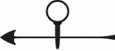

Dapr components
State
Stores
AWS
DynamoDB
Azure
CosmosDB
Firebase
Redis
Cassandra
PubSub
Brokers
AWS
SQS
Azure
Service Bus
GCP
Pub/Sub
Redis
RabbitMQ
My App
Bindings
& Triggers
AWS
S3
Azure
Storage
GCP
Storage
Twilio
Kafka
Swappable YAML files with
resource connection details
Over 70 components available
Create components for your resource at: github.com/dapr/components-contrib
Secret
Stores
AWS
Secrets Manager
Azure
KeyVault
GCP
Secret Manager
HashiCorp
Vault
Kubernetes
Secret
Observability
Prometheus
AppInsights
Zipkin
Jaeger

Slide 16
Dapr building blocks
Service-to- service invocation
State management
Publish and subscribe
Bindings
(input/output)
Actors
Observability
Secrets
Perform direct, secure, service-to-service method calls
Create long running, stateless and stateful services
Secure, scalable messaging between services
Trigger code through events from a large array of inputs
Input and output bindings to external resources including databases and queues
Encapsulate code and data in reusable actor objects as a common microservices design pattern
See and measure the message calls across components and networked services
Securely access secrets from your application

Slide 17
Service invocation
mDNS
Multicast DNS component for service discovery
My App
Service A
mTLS encryption
POST
http://localhost:3500/v1.0/invoke/servicea/method/neworder
POST
http://10.0.0.2:8000/neworder
{"data":"Hello World"}
{"data":"Hello World"}

Slide 18

State management
Redis Cache
My App
key | value
myApp-weapon | "DeathStar"
POST
http://localhost:3500/v1.0/state/corpdb
[{
"key": "weapon",
"value": "DeathStar"
}]

Slide 19
State management
Redis Cache
Azure CosmosDB
My App
key | value
myApp-weapon | "DeathStar"
key | value
myApp-weapon | "DeathStar"
GET
http://localhost:3500/v1.0/state/corpdb/planet
"DeathStar"

Slide 20
State management
Azure CosmosDB
Redis Cache
My App
key | value
myApp-weapon | "DeathStar"
key | value
myApp-weapon | "DeathStar"
GET
http://localhost:3500/v1.0/state/corpdb/planet
"DeathStar"

Slide 21
Dapr state API
corpdb-redis.yaml
apiVersion: dapr.io/v1alpha1
kind: Component
metadata:
name: corpdb
spec:
type: state.redis
version: v1
metadata:
- name: redisHost
value: redis-master.default.svc.cluster.local:6379
- name: redisPassword
secretKeyRef:
name: redis-secret
key: redis-password
Save state
POST /v1.0/state/corpdb
Retrieve state
GET /v1.0/state/corpdb/mystate
Delete state
DELETE /v1.0/state/corpdb/mystate
Get bulk state
POST /v1.0/state/corpdb/bulk
Submit multiple state transactions
POST /v1.0/state/corpdb/transaction

Slide 22
Dapr state API
corpdb-cosmosdb.yaml
apiVersion: dapr.io/v1alpha1
kind: Component
metadata:
name: corpdb
spec:
type: state.azure.cosmosdb
version: v1
metadata:
- name: url
value: corpdb.documents.azure.com
- name: masterKey
secretKeyRef:
name: master-key
key: cosmos-key
- name: database
value: orders
- name: collection
value: processed
Save state
POST /v1.0/state/corpdb
Retrieve state
GET /v1.0/state/corpdb/mystate
Delete state
DELETE /v1.0/state/corpdb/mystate
Get bulk state
POST /v1.0/state/corpdb/bulk
Submit multiple state transactions
POST /v1.0/state/corpdb/transaction

Slide 23
Publish and subscribe
Service A
My App
Redis
Cache
Service B
POST
http://localhost:3500/v1.0/publish/orders/processed
POST
http://10.0.0.2:8000/orders
http://10.0.0.4:8000/factory/orders
{"data":"Hello World"}
{"data":"Hello World"}

Slide 24
Dapr pub/sub API
orders.yaml
apiVersion: dapr.io/v1alpha1
kind: Component
metadata:
name: orders
spec:
type: pubsub.redis
metadata:
- name: redisHost
value: leader.redis.svc.cluster.local:6379
- name: redisPassword
secretKeyRef:
name: redis-secret
key: password
- name: allowedTopics
value: "processed,audit"
App-to-sidecar
Publish a message
POST /v1.0/publish/orders/processed
Sidecar-to-app
Get app subscriptions
GET /dapr/subscribe
Publish to app
POST /order-processing

Slide 25

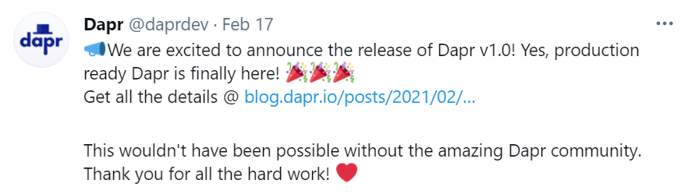
Input triggers
Twitter
My App
POST
http://10.0.0.2:8000/newtweet
{"data":“📢 We are excited to announce the …"}

Slide 26

Output bindings
My App
Twilio
POST
http://localhost:3500/v1.0/bindings/twilio
Hello World
{"data":"Hello World"}

Slide 27
Dapr bindings API
twitter.yaml
apiVersion: dapr.io/v1alpha1
kind: Component
metadata:
name: twitter
spec:
type: bindings.twitter
version: v1
metadata:
- name: consumerKey
secretKeyRef:
name: twitter-secret
key: consumerKeys
- name: consumerSecret
secretKeyRef:
name: twitter-secret
key: consumerSecret
- name: accessToken
secretKeyRef:
name: twitter-secret
key: accessToken
- name: accessSecret
secretKeyRef:
name: twitter-secret
key: accessSecret
App-to-sidecar
Invoke an output binding
POST/PUT /v1.0/bindings/twitter
Sidecar-to-app
Trigger an app
OPTIONS/POST /new-tweet

Slide 28

Secrets
My App
HahsiCorp Vault
key | value
mysecret | "supersecret"
GET
http://localhost:3500/v1.0/secrets/vault/mysecret
"supersecret"

Slide 29
Dapr secrets API
vault.yaml
apiVersion: dapr.io/v1alpha1
kind: Component
metadata:
name: vault
spec:
type: secretstores.hashicorp.vault
metadata:
- name: vaultAddr
value: https://127.0.0.1:8200
- name: caCert
value: "ca_cert"
- name: caPath
value: "/certs/cert.pem"
- name: caPem
value: "/certs/ca.pem”
App-to-sidecar
Retrieve a secret
GET /v1.0/secrets/vault/mysecret
Retrieve secrets in bulk
GET /v1.0/secrets/vault/bulk

Slide 30
Virtual actors
Host/Pod
Stateful, objects of storage and compute
Dapr Actor features:
Distribution and failover
Turn-based concurrency
State management
Timers
Reminders
Video Game Enemy
X pos
Y pos
Z pos
Difficulty
Spawn( )
Host/Pod
Weapons
Attack( )
Virtually identical to Service Fabric Reliable Actors

Slide 31
Virtual actors
Actor B
Actor E
My
Actor
Pod 1
Actor A
Actor G
Dapr actor placement service
Placement
Actor C
Actor F
My App
Actor Y
Actor V
POST
http://localhost:3500/v1.0/actors/MyActor/A/method/update
My
Actor
Pod 2
Actor Z
Actor T
{"speed":"1"}
Actor X
Actor U

Slide 32
Dapr actors API
App-to-sidecar
Invoke an actor method
POST/GET /v1.0/actors/MyActor/A/method/update
Save actor state
POST/PUT /v1.0/actors/MyActor/A/state
Get actor state
GET /v1.0/actors/MyActor/A/state/status
Create actor reminder
POST/PUT /v1.0/actors/MyActor/A/reminders/process
Create actor timer
POST/PUT /v1.0/actors/MyActor/A/timers/process
Sidecar-to-actor
Invoke an actor method
PUT /actors/MyActor/A/method/update
Deactivate actor
DELETE /actors/MyActor/A
Invoke actor reminder
PUT /actors/MyActor/A/method/remind/process
Invoke actor timer
PUT /actors/MyActor/A/method/timer/process
Health check
GET /healthz

Slide 33




Observability
Service A
Twitter
My App
Redis
Cache
Service B
OpenTelemetry collector
Logging &
tracing extensions

Slide 34

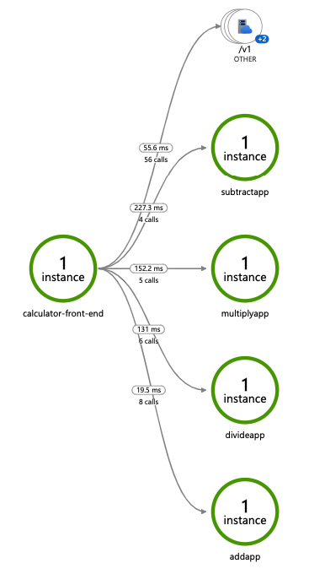
Distributed tracing
Emit tracing data from calls to/from Dapr sidecars and system services for easy application-level instrumentation
Dapr distributed tracing features:
Built-in Zipkin collection and viewer
Configurable sampling rates
TBD
TBD
TBD

Slide 35

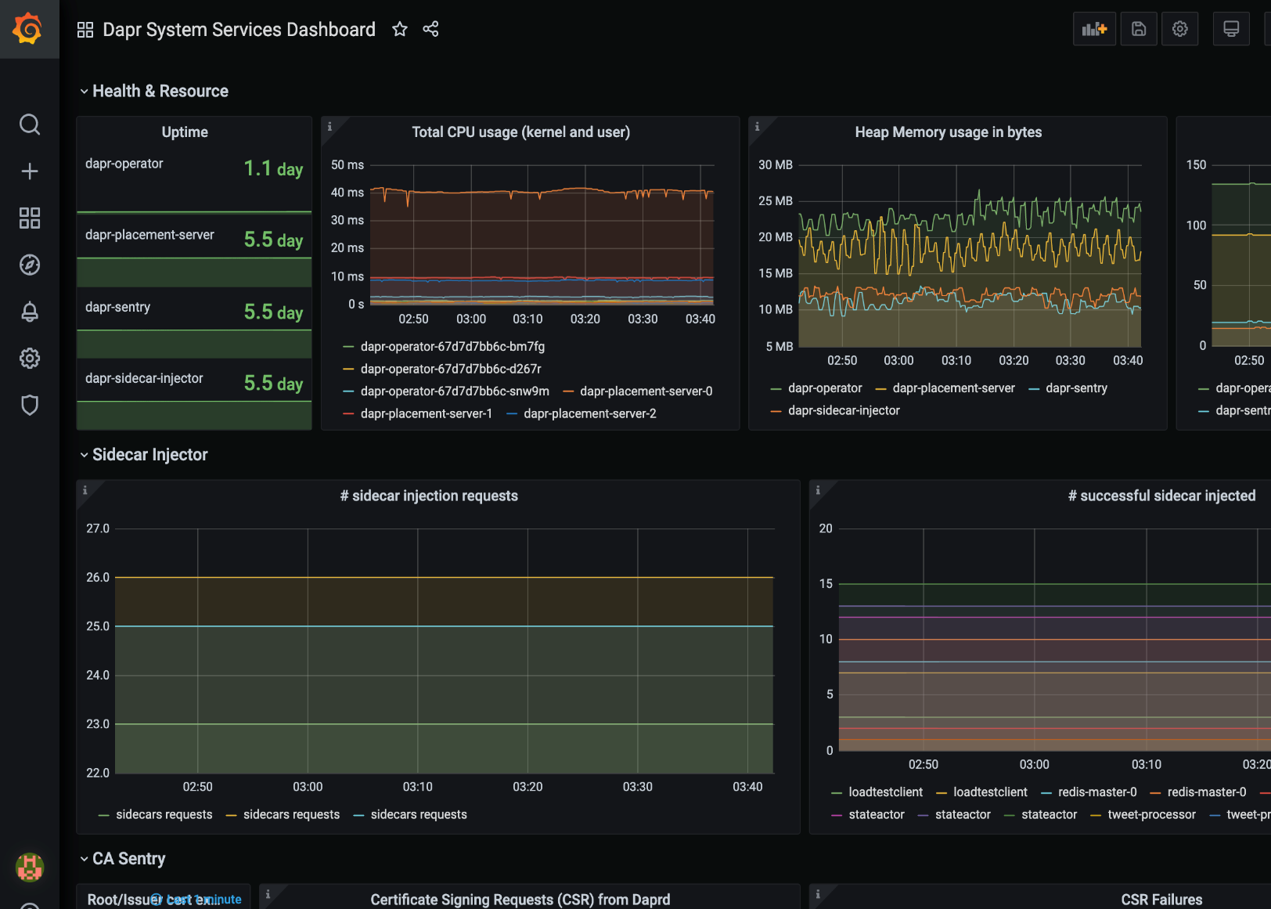
Metrics
Built-in monitoring capabilities to understand the behavior of the Dapr sidecar and system services
Dapr Metrics features:
Call latency
CPU/memory usage
Error rates
Sidecar injection failures
System health

Slide 36
Dapr hosting environments
Get started with dapr init
Easy setup with Docker images
Sets up placement, Zipkin, Redis
slim-init available without Docker
Run any application with Dapr sidecar using dapr run
Get started with dapr init -k
Fully managed Dapr control plane
Deploys dashboard, placement, operator, sentry, and injector pods
Automatically inject Dapr sidecar into all annotated pods
Upgrade with dapr upgrade or Helm
Self-hosted

Slide 37






Dapr in self-hosted Docker mode
Dapr Components
dapr run myapp
State Stores
Launch application
Launch sidecar process
Set env variables
Actor
placement
PubSub
Brokers
Placement
Create mapping table of actor instances to pods
My App
Use components
Bindings
& Triggers
Zipkin
tracing
Zipkin
Send distributed tracing
Secret Stores
Redis
state store
Redis
Save and retrieve state
Publish and subscribe to messages
Local dev machine or virtual machine
Observability

Slide 38


Dapr on Kubernetes
Operator
Deploys and manages Dapr
Dapr Components
Pod
Pod
Pod
Pod
State Stores
Actor partition placement
Dapr
runtime
injector
Cert authority
and identity
Update component
changes
Placement
Injector
Sentry
Operator
Pub/Sub
Brokers
Create mapping table of actor instances to pods
Inject Dapr sidecar into annotated pods
Inject env variables
Manage mTLS between services
Assign spiffe identity
Manage component updates
Manage Kubernetes
service endpoints
Pod
Bindings
& Triggers
My App
Secret Stores
Readiness and Liveness probe on healthz API to determine Dapr health state
Kubelet
Use components
Observability
Any cloud or edge infrastructure

Slide 39
Dapr and service meshes
Application code
Any code or framework…
Developer
Service-to-service invocation
State management
Publish and subscribe
Resource bindings and triggers
Secrets
Actors
mTLS
Metrics
Resiliency
Distributed tracing
Service Mesh
Traffic routing
Traffic splitting
Hosting infrastructure
Operator

